Slide 1
Report from the Foundation
Stephen Keizer
Paul Grier
David Loleng
www.PresbyterianFoundation.org

Slide 2
Stephen M. Keizer
Vice-President
Kalamazoo, Michigan
1-866-317-0751
Stephen.Keizer@PresbyterianFoundation.org

Slide 3
Ministry Relations
Stewardship Resources
Planned Giving Services
Investments
Ministry Relations Officers

Slide 4
Paul H. Grier
Vice-President
Greenville, South Carolina
1-800-858-6127 x-5953
Paul.Grier@PresbyterianFoundation.org

Slide 5
Project Regeneration A Church Asset Transformation Program
Who?
Congregations, Presbyteries, and parachurch ministries who are questioning their organizational sustainability
Running out of people … running out of money
Reinventions
Nesting & Mergers
Dissolution
Scale:
42 states + District of Columbia
453 individual situations
urban & rural
historic & new
South & North & West & East
congregations ranging from 4 – 1000 members

Slide 6
Project Regeneration A Church Asset Transformation Program
What?
More questions and organizing than answers
assistance with discernment
assistance with execution
Why?
experience elsewhere
congregational loneliness

Slide 7
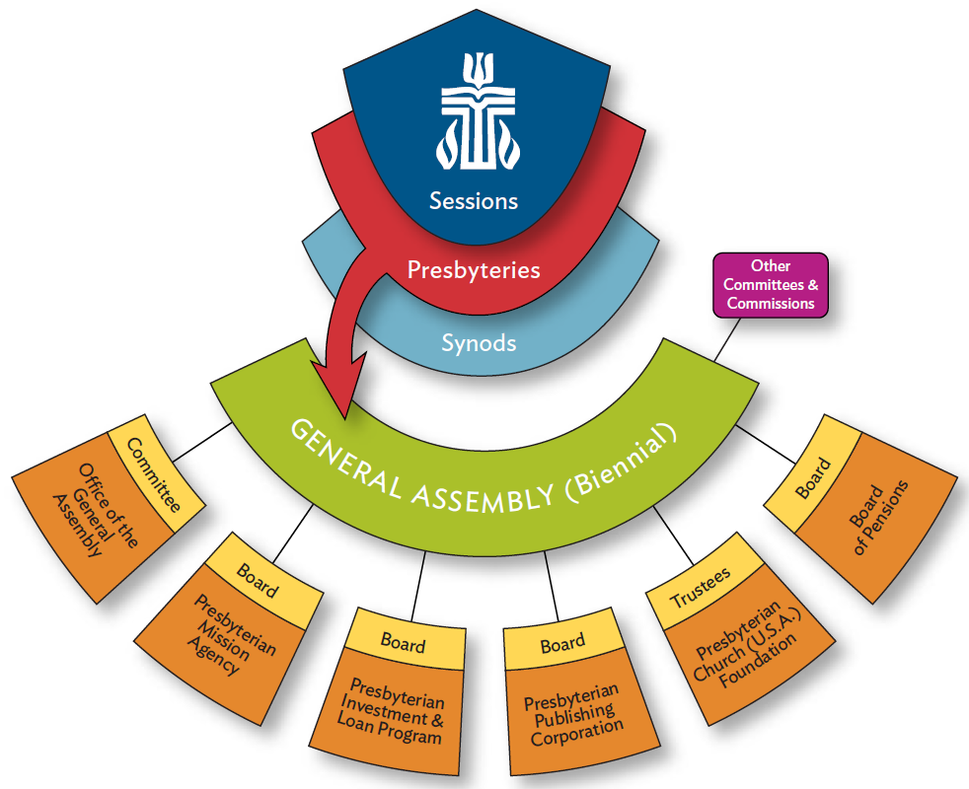

Slide 8
Project Regeneration A Church Asset Transformation Program
When?
Sooner rather than later
If you think a church has a “runway” of three years or less
Anonymous referrals are honored

Slide 9
Presbytery Assessment Tool
Predicated on the success of the Foundation’s Online Financial Health Assessment
Almost 1,000 congregations have participated
http://assessment.PresbyterianFoundation.org

Slide 10
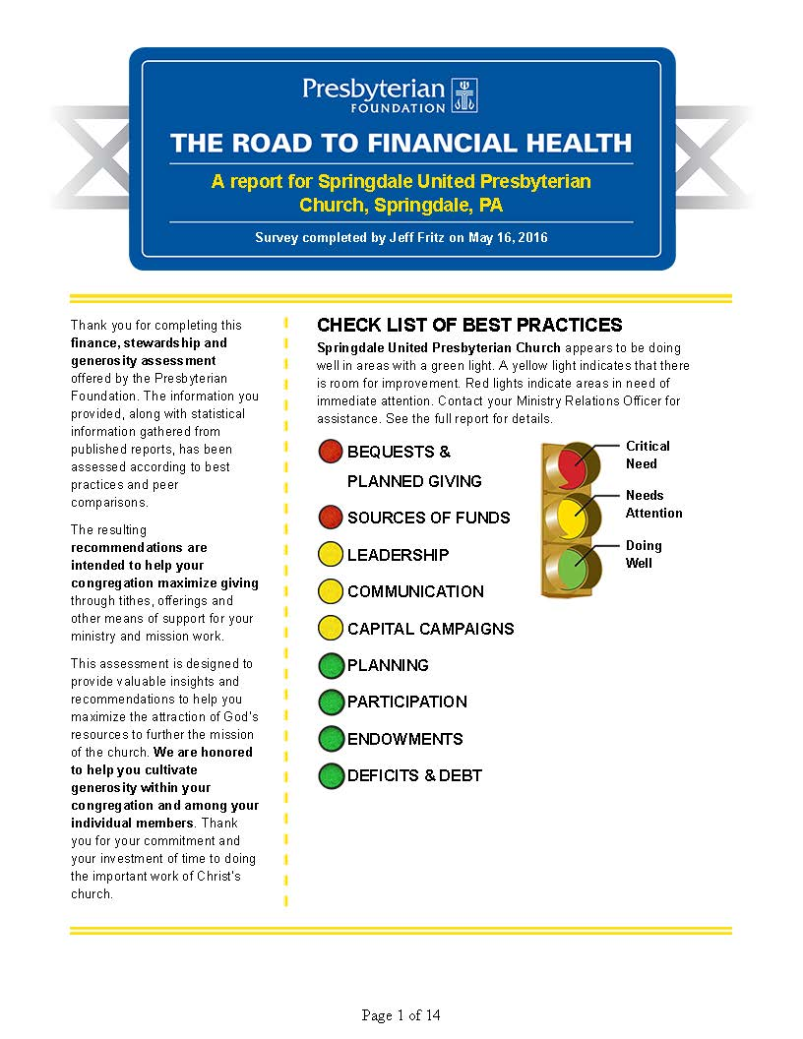

Slide 12
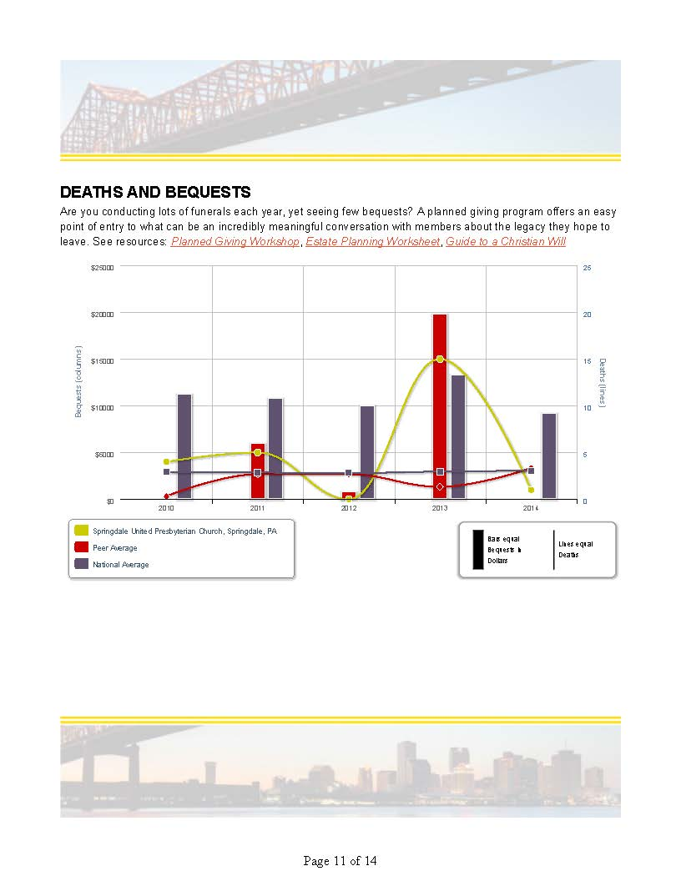

Slide 13
Presbytery Assessment Tool
Purpose:
To develop a dataset so that presbytery Treasurers and other leaders can compare metrics against others
To provide reference points, especially for that Finance Committee member who’s always asking about “best practices”
Progress:
Focus group
Alpha Group has been identified
Data-gathering has begun
Beta Group expressions of interest welcome

Slide 14
David Loleng
Director, Church of Financial Literacy & Leadership
Jeffersonville, Indiana
1-800-858-6127 x-5901
David.Loleng@PresbyterianFoundation.org

Slide 16
Report from the Foundation
Stephen Keizer
Paul Grier
David Loleng
www.PresbyterianFoundation.org

