Slide 1
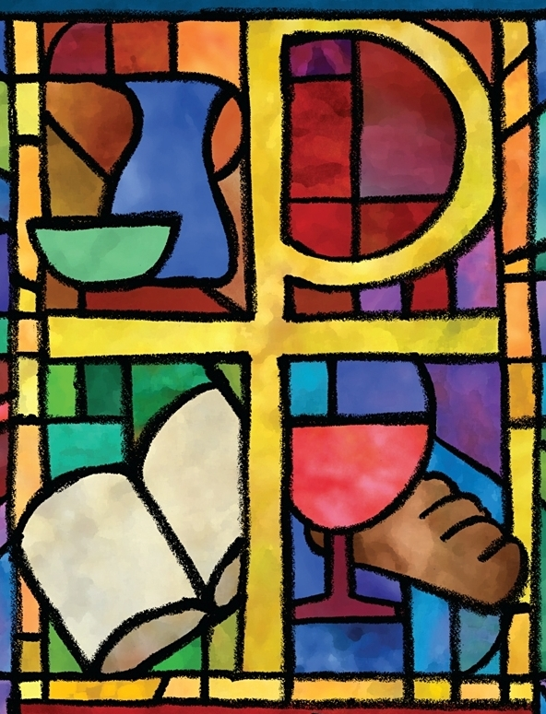
The PC(USA) Constitution on Dismantling Structural Racism
Office of Theology and Worship Presbyterian Church (U.S.A.)
Name of Presenter

Slide 2
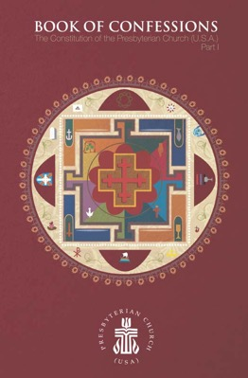
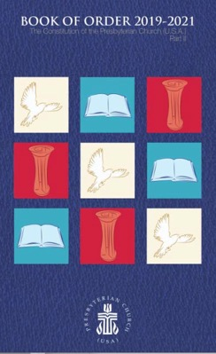
About This Presentation
All of the primary texts in this presentation come from the Constitution of the Presbyterian Church (U.S.A.), which is composed of The Book of Confessions (Part I) and The Book of Order (Part II).
Most images come from “Art in the Christian Tradition,” an online collection of the Jean and Alexander Heard Libraries of the Vanderbilt University Divinity School.

Slide 3
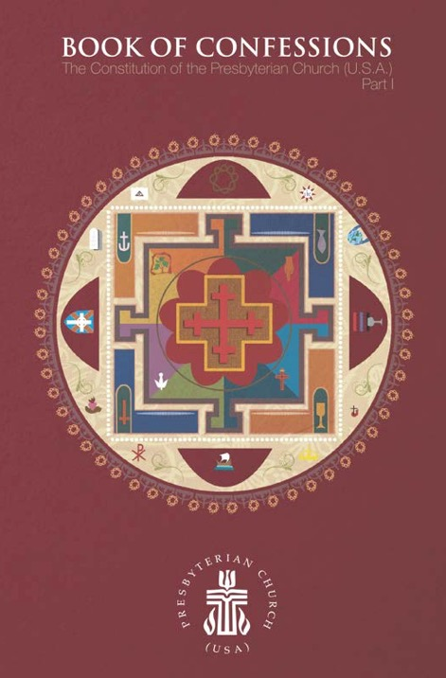
What Are the Confessions?
The Presbyterian Church (U.S.A.) states its faith and bears witness to God’s grace in Jesus Christ in the creeds and confessions in the Book of Confessions. In these statements the church declares to its members and to the world who and what it is, what it believes, and what it resolves to do. These statements identify the church as a community of people known by its convictions as well as by its actions. —Book of Order, F-2.01

Slide 4
The Confession of 1967
Written for the United Presbyterian Church in the United States of America, the Confession of 1967 sought to address critical issues for the church and society in the mid-twentieth century. A key theme is reconciliation.
This presentation highlights excerpts from the Confession of 1967 pertaining to the work of dismantling structural racism.

Slide 5
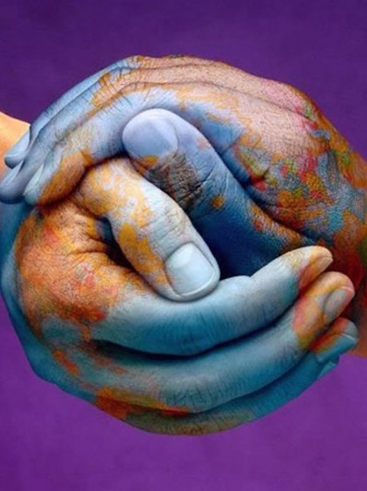
The Confession of 1967
God has created the peoples of the earth to be one universal family. In [God’s] reconciling love, [God] overcomes the barriers between [us] and breaks down every form of discrimination based on racial or ethnic difference, real or imaginary. The church is called to bring all [people] to receive and uphold one another as persons in all relationships of life: in employment, housing, education, leisure, marriage, family, church, and the exercise of political rights.
“Hands of the World,” Graphic Design for Movement for Peace, 21st Century

Slide 6
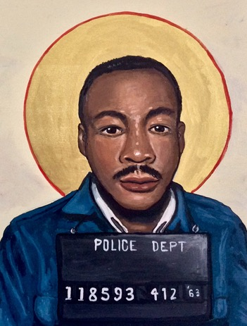
The Confession of 1967
Therefore, the church labors for the abolition of all racial discrimination and ministers to those injured by it. Congregations, individuals, or groups of Christians who exclude, dominate, or patronize [others], however subtly, resist the Spirit of God and bring contempt on the faith which they profess. —Book of Confessions, 9.44
“Martin Luther King Jr.,” Kelly Latimore, 2019

Slide 7
Questions for Discussion or Reflection
What does the Confession of 1967 have to say about dismantling structural racism?
With respect to structural racism, how does this confession declare who we are, what we believe, and what we resolve to do?
How does it state our convictions? How might it shape our actions?

Slide 8
The Confession of Belhar
Written in the Dutch Reformed Mission Church in the context of South African apartheid, the Confession of Belhar was adopted in 1986. It condemns the sin of racism and calls for unity and justice in the church.
This presentation highlights excerpts from the Confession of Belhar pertaining to the work of dismantling structural racism.

Slide 9
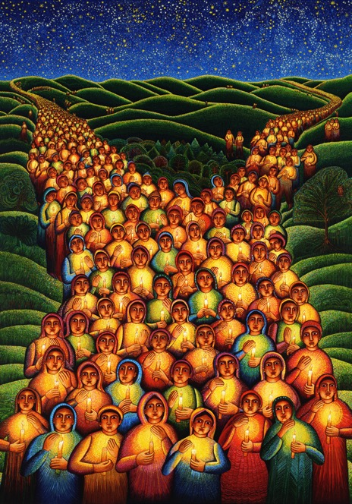
The Confession of Belhar
We believe
• that God has entrusted the church with the message of reconciliation in and through Jesus Christ;
• that the church is called to be the salt of the earth and the light of the world, that the church is called blessed because it is a peacemaker, that the church is witness both by word and by deed to the new heaven and the new earth in which righteousness dwells;
“Festival of Lights,” John August Swanson, 2000

Slide 10
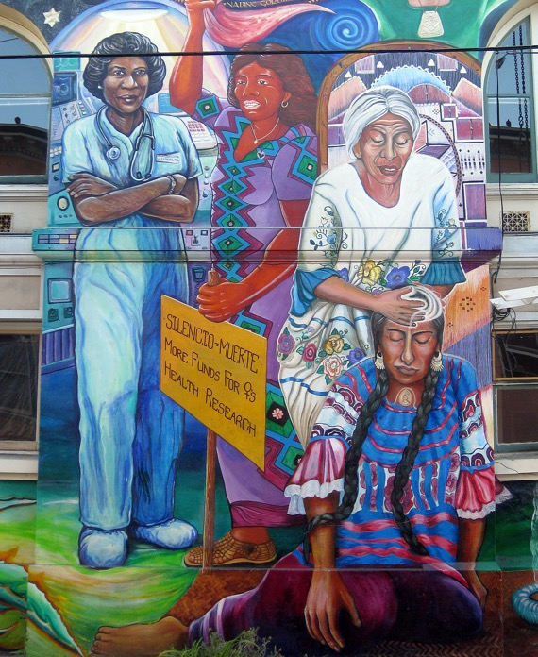
The Confession of Belhar
[We believe]
• that God’s life-giving Word and Spirit has conquered the powers of sin and death, and therefore also of irreconciliation and hatred, bitterness and enmity, that God’s life-giving Word and Spirit will enable the church to live in a new obedience which can open new possibilities of life for society and the world;
“Maestra Peace Mural,” Juana Alicia, 1994

Slide 11
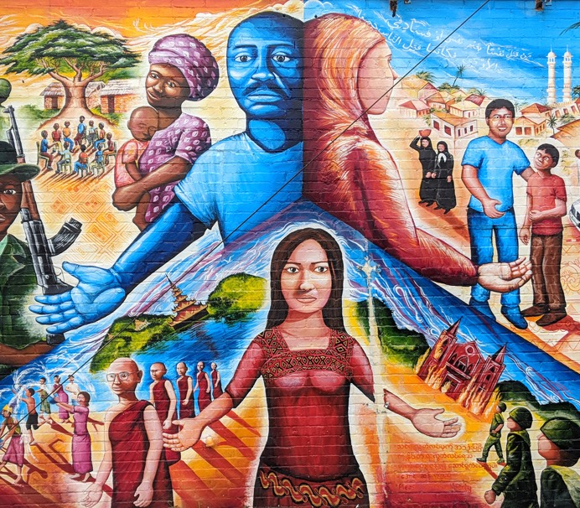
The Confession of Belhar
[We believe]
• that the credibility of this message is seriously affected and its beneficial work obstructed when it is proclaimed in a land which professes to be Christian, but in which the enforced separation of people on a racial basis promotes and perpetuates alienation, hatred and enmity;
“Global Refugee Mural,” Joel Burgner, 2009

Slide 12
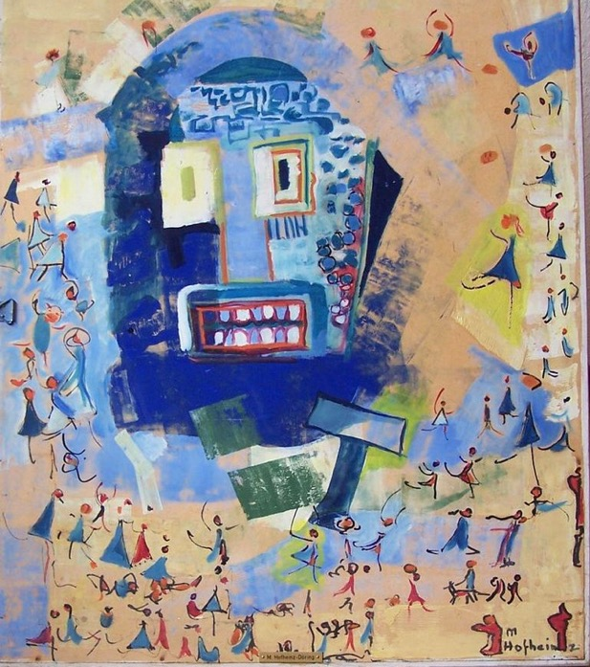
The Confession of Belhar
[We believe]
• that any teaching which attempts to legitimate such forced separation by appeal to the gospel, and is not prepared to venture on the road of obedience and reconciliation, but rather, out of prejudice, fear, selfishness and unbelief, denies in advance the reconciling power of the gospel, must be considered ideology and false doctrine. —Book of Confessions, 10.6
“Worship of the Golden Calf,” Margret Hofheinz-Döring, 1962

Slide 13
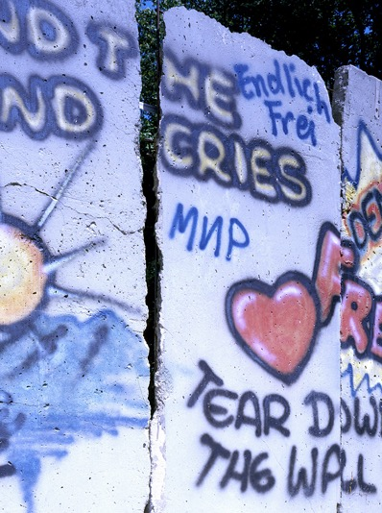
The Confession of Belhar
Therefore, we reject any doctrine which, in such a situation sanctions in the name of the gospel or of the will of God the forced separation of people on the grounds of race and color and thereby in advance obstructs and weakens the ministry and experience of reconciliation in Christ. —Book of Confessions, 10.6
Piece of the Berlin Wall, ca. 1989

Slide 14
Questions for Discussion or Reflection
What does the Confession of Belhar have to say about dismantling structural racism?
With respect to structural racism, how does this confession declare who we are, what we believe, and what we resolve to do?
How does it state our convictions? How might it shape our actions?

Slide 15
A Brief Statement of Faith
Written in the time following the 1983 reunion that formed the Presbyterian Church (U.S.A.), A Brief Statement of Faith articulated the commitments and convictions of the new denomination. It is trinitarian in form and designed for use in worship.
This presentation highlights excerpts from A Brief Statement of Faith pertaining to the work of dismantling structural racism.

Slide 16
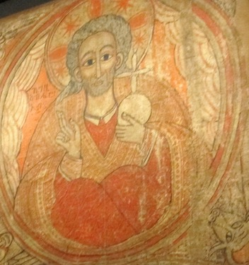
A Brief Statement of Faith
We trust in God, whom Jesus called Abba, Father.
Mural from the Church of Abba Antonius, Ethiopia, 1690–1710

Slide 17
A Brief Statement of Faith
In sovereign love God created the world good and makes everyone equally in God’s image, male and female, of every race and people, to live as one community.
“Be Thou My Vision,” Mike Moyers, 2013

Slide 18
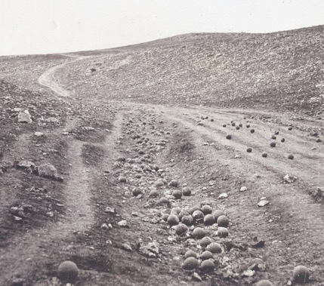
A Brief Statement of Faith
But we rebel against God; we hide from our Creator. Ignoring God’s commandments, we violate the image of God in others and ourselves, accept lies as truth, exploit neighbor and nature, and threaten death to the planet entrusted to our care. We deserve God’s condemnation.
“Valley of the Shadow of Death,” Roger Fenton, 1855

Slide 19
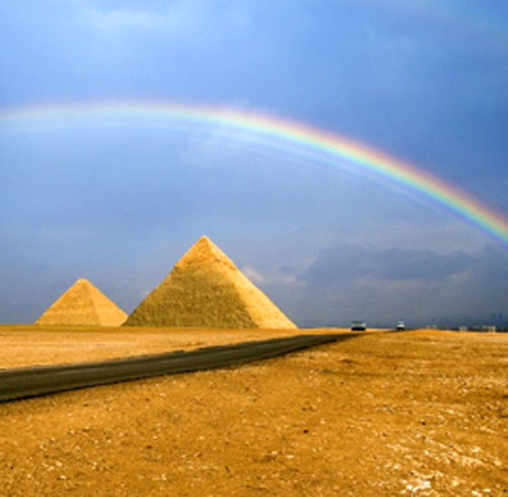
A Brief Statement of Faith
Yet God acts with justice and mercy to redeem creation.
In everlasting love, the God of Abraham and Sarah chose a covenant people to bless all families of the earth.
Hearing their cry, God delivered the children of Israel from the house of bondage.
“Rainbow Over the Pyramid,” Hai Thinh, 2008

Slide 20
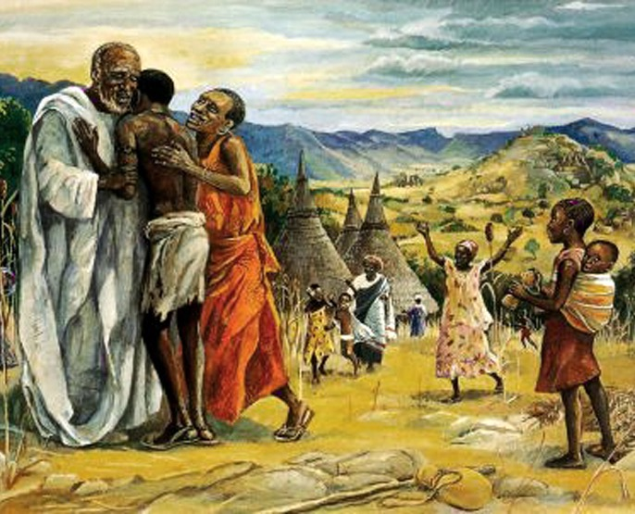
A Brief Statement of Faith
Loving us still, God makes us heirs with Christ of the covenant.
Like a mother who will not forsake her nursing child, like a father who runs to welcome the prodigal home, God is faithful still. —Book of Confessions, 11.3
”Prodigal Son,” JESUS MAFA, 1970

Slide 21
Questions for Discussion or Reflection
What does a Brief Statement of Faith have to say about dismantling structural racism?
With respect to structural racism, how does this confession declare who we are, what we believe, and what we resolve to do?
How does it state our convictions? How might it shape our actions?

Slide 22
The Foundations of Presbyterian Polity
The Foundations of Presbyterian Polity sets forth the principles that undergird the church’s mission, faith, and form of government.
This presentation highlights excerpts from the Foundations of Presbyterian Polity pertaining to the work of dismantling structural racism.

Slide 23
The Foundations of Presbyterian Polity
Unity in Diversity
“As many of you as were baptized into Christ have clothed yourselves with Christ. There is no longer Jew or Greek, there is no longer slave or free, there is no longer male and female; for all of you are one in Christ Jesus. And if you belong to Christ, then you are Abraham’s offspring, heirs according to the promise” (Gal. 3:27–29).
“NOLA Map,” Lauren Wright Pittman, 2013

Slide 24
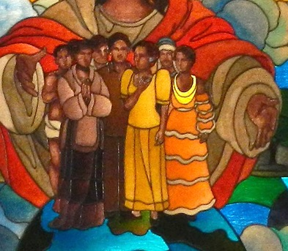
The Foundations of Presbyterian Polity
The unity of believers in Christ is reflected in the rich diversity of the Church’s membership. In Christ, by the power of the Spirit, God unites persons through baptism regardless of race, ethnicity, age, sex, disability, geography, or theological conviction. There is therefore no place in the life of the Church for discrimination against any person.
“Christ Cares for All,” Pangasinan, Philippines, 20th Century

Slide 25
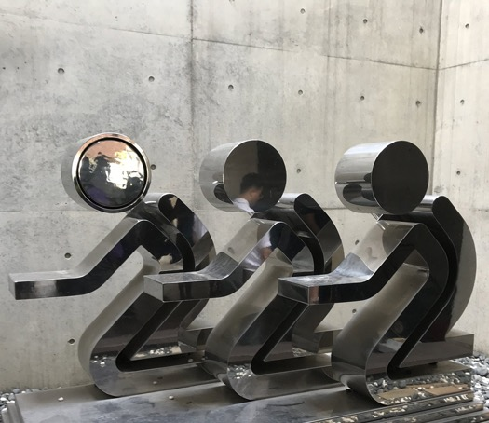
The Foundations of Presbyterian Polity
The Presbyterian Church (U.S.A.) shall guarantee full participation and representation in its worship, governance, and emerging life to all persons or groups within its membership. No member shall be denied participation or representation for any reason other than those stated in this Constitution. — Book of Order, F-1.0403
“Prayer Sculpture,” Pyeongtaek, Korea, 2014

Slide 26
Questions for Discussion or Reflection
What does the section on “Unity in Diversity” in the Foundations of Presbyterian Polity have to say about dismantling structural racism?
With respect to structural racism and in light of the Confessions, how do the Foundations of Presbyterian Polity inform the identity and mission of the church?
How can Presbyterian polity contribute to dismantling structural racism?

Slide 27
The Form of Government
The Form of Government establishes the organization of the denomination, defining membership and ministry and determining structures of oversight for the church’s mission.
This presentation highlights excerpts from the Form of Government pertaining to the work of dismantling structural racism.

Slide 28
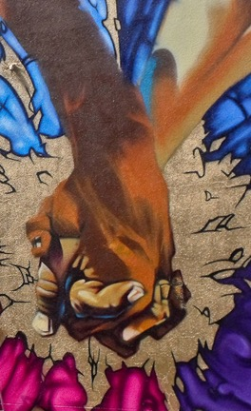
The Form of Government
Participation and Representation
The councils of the church shall give full expression to the rich diversity of the church’s membership and shall provide for full participation and access to representation in decision-making and employment practices (F-1.0403). In fulfilling this commitment, councils shall give due consideration to both the gifts and requirements for ministry (G-2.0104) and the right of people in congregations and councils to elect their officers (F-3.0106).
“Elements of Peace,” Mural, 21st Century

Slide 29
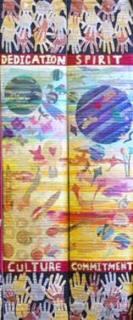
The Form of Government
Each council shall develop procedures and mechanisms for promoting and reviewing that body’s implementation of the church’s commitment to inclusiveness and representation. Councils above the session shall establish by their own rule committees on representation to fulfill the following functions: to advise the council regarding the implementation of principles of unity and diversity, to advocate for diversity in leadership, and to consult with the council on the employment of personnel, in accordance with the principles of unity and diversity in F-1.0403.
”Hands Around the World” Mural, Victoria, Canada, 2012

Slide 30
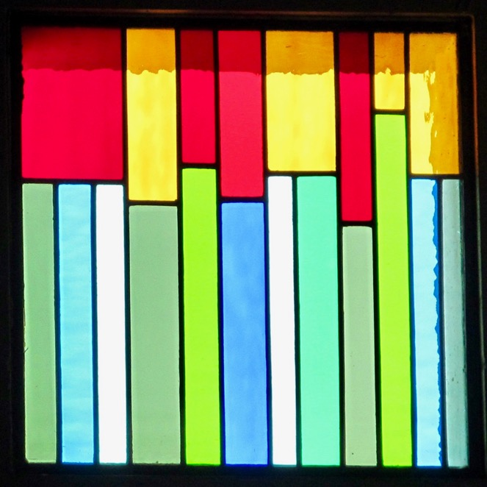
The Form of Government
A committee on representation should not be merged with another committee or made a subcommittee of another committee. — Book of Order, G-3.0103
“Pentecost,” Cape Town, South Africa, 2019

Slide 31
Questions for Discussion or Reflection
What does the guidance on “Participation and Representation” in Form of Government have to do with dismantling structural racism?
With respect to structural racism and in light of the Confessions, how does the Form of Government inform the identity and mission of the church?
How are we called to dismantle structural racism through the governance of the church?

Slide 32
The Directory for Worship
The Directory for Worship presents the denomination’s theology and practice of worship, with an understanding of worship that includes service to God and neighbor.
This presentation highlights excerpts from the Directory for Worship pertaining to the work of dismantling structural racism.

Slide 33
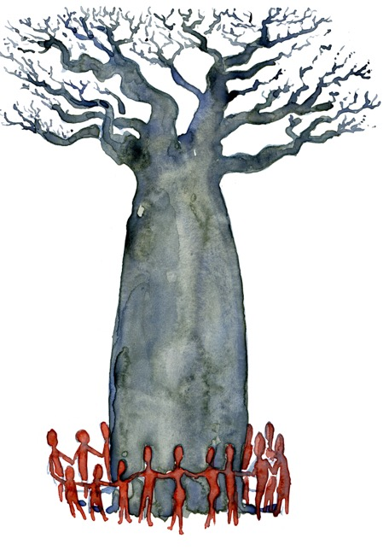
The Directory for Worship
Justice and Peace
God sends the Church to work for justice in the world: exercising its power for the common good; dealing honestly in personal and public spheres; seeking dignity and freedom for all people; welcoming strangers in the land; promoting justice and fairness in the law; overcoming disparities between rich and poor; bearing witness against systems of violence and oppression; and redressing wrongs against individuals, groups, and peoples.
“People Around a Baobab Tree,” Frits Ahlefeldt, 2018

Slide 34
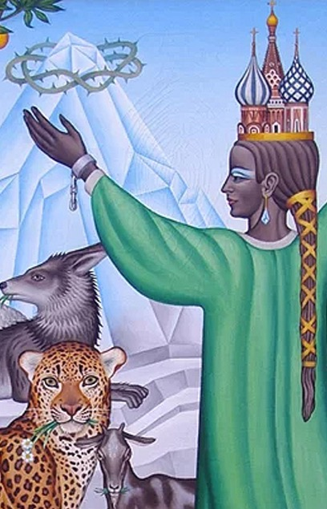
The Directory for Worship
God also sends the Church to seek peace: in the Church universal, within denominations, and at the congregational level; in the world, where nations and religious or ethnic groups make war against one another; and in local communities, schools, workplaces, neighborhoods, and homes. These acts of peacemaking and justice are established upon God’s gracious act of reconciliation with us in Jesus Christ, and are a way of participating in Christ’s priestly intercession or advocacy for the world.
“Great Peace,” Peter Koenig, 20th Century

Slide 35
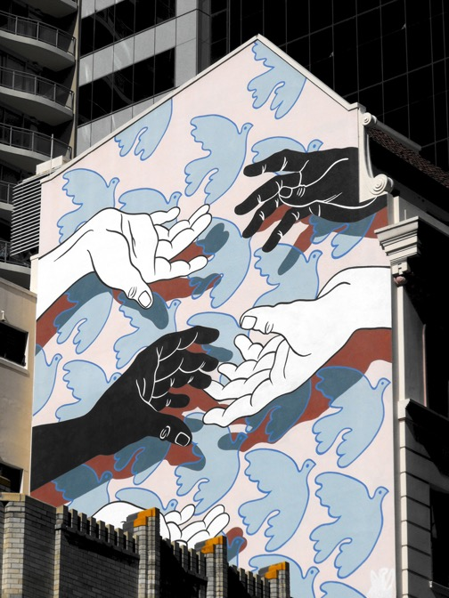
The Directory for Worship
In the Service for the Lord’s Day we proclaim, receive, and enact reconciliation with God in Christ. Through the proclamation of the Word we are given the assurance of freedom and peace in Christ and are inspired to share these gifts with others. Through Baptism and the Lord’s Supper we are united with Christ, made one in the Spirit, and empowered to break down the dividing walls of hostility that still separate us from one another.
“Peace, Justice, Unity,” Public Art Squad, 1984

Slide 36
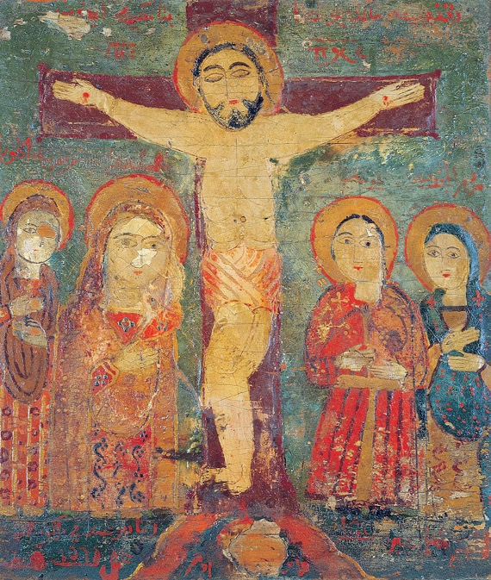
The Directory for Worship
We confess our participation in unjust systems, pray for an end to violence and injustice, offer our gifts to support Christ’s liberating work, and commit ourselves to pursue peace and justice in Jesus’ name. —Book of Order, W-5.0304
Icon of the Crucifixion, Syria or Egypt, ca. 1560

Slide 37
Questions for Discussion or Reflection
What does the Directory for Worship passage on “Justice and Peace” have to say about dismantling structural racism?
With respect to structural racism and in light of the Confessions, how does the Directory for Worship inform the identity and mission of the church?
How are we called to dismantle structural racism in worship?

Slide 38
Additional Resources
For more information on the Matthew 25 vision of the Presbyterian Church (U.S.A.), including resources for dismantling structural racism, visit pcusa.org/Matthew25.

